Slide 1
Life cycle in Simulation
1

Slide 2
2
A good way to understand modeling and simulation (M&S) is to look at the process through which models and simulations are developed.
In a simulation study, there is the person who has a problem that needs to be solved (the client) and the person or group that will solve the problem by developing a simulation model (the simulation analyst).

Slide 3
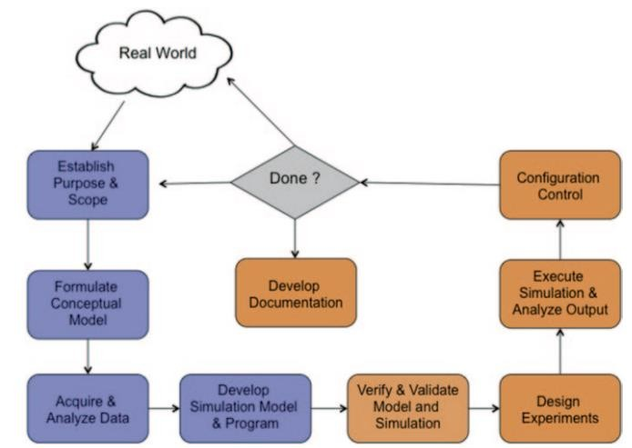
3

Slide 4
Steps in the Process
4
Establish Purpose and Scope:
Every simulation study begins with a statement of the problem.
Without an understanding of the objectives to be addressed, it is likely the study will not be successful.

Slide 5
Formulate the Conceptual Model:
5
The conceptual model is an abstraction of the real-
world system under investigation.
A simulation conceptual model is a living document that grows from an informal description to a formal description and serves to communicate between the
diverse groups participating in the simulation’s
development.
18-Jan-19

Slide 6
6
It describes what is to be represented, the assumptions
limiting those representations, and other capabilities
(e.g., data) needed to satisfy the user’s requirements.
18-Jan-19

Slide 7
Develop Simulation Model and Program
7
In this step, the conceptual model is coded into a
computer recognizable form, an operational model.
Translating the model into computer code and then into an executable involves selecting the most appropriate simulation methodology (e.g., discrete event, continuous, agents, or system dynamics and an appropriate computer implementation (e.g., programming or simu18l-aJatni-o19n language).

Slide 8
Verify and Validate the Model and Simulation
8
Verification is the process of determining that a model or
simulation
accurately
implementation
represent
and its associated data
the developer’s conceptual
description and specifications.
It is often summarized as “Did we build the model right?”
Validation is process of determining the degree to which a model or simulation and its associated data are an accurate representation of the real world.
It is often summarized as “Did we build t¹h⁸⁻e^{Jan}r⁻i¹g⁹ ht model?”

Slide 9
Design Experiments
9
For each scenario that is to be simulated, decisions need
to be made concerning the length of the simulation run, the number of runs (also called replications), and the manner of initialization that is required.
18-Jan-19

Slide 10
Execute Simulation and Analyze Output
10
The final runs, in which data are collected for analysis, are
known as production runs.
They are used to estimate measures of performance (MOP) for the scenarios that are being simulated.
By analyzing the MOP of the production runs, the simulation analyst determines if additional runs are needed and if any additional scenarios need to be simulated.
Analyzing the results could indicate that the simulation needs to be modified. 18-Jan-19

Slide 11
Configuration Control
11
A simulation package for a real-world project can be made up of thousands to millions of lines of computer code.
Some computer simulation packages could be a collection of several individual software packages linked together.
What may seem like a small change can lead to large excursions in the behavior of the overall simulation.
Thus, it is important to keep control of the package and its
contents, known as its “configuration.”
18-Jan-19

Slide 12
Develop Documentation
12
Documentation is a very important part of the simulation process.
If the simulation model is going to be used again by the same or different analysts, it may be necessary to understand how the simulation model operates.
Also, if the model is to be modified, this can be greatly facilitated by adequate documentation.

Slide 13
Develop Documentation Cont’
13
It is important that all the simulation inputs are
documented.
All the simulation interfaces need to be identified, and the format of all the input data, and their units or dimensions, needs to be specified

Slide 14
Discrete Events Simulation
14

Slide 15
Objectives
15
Understand the concept of simulation
Understand the concept of discrete event simulation

Slide 16
Discrete Event Simulation - Some terminology -1
System Environment: the collection of external factors capable of causing a change in the system.
State of a System: the minimal collection of information with which the future behavior of a system can be reliably (uniquely?) predicted.
Activity: any events that causes a State Change.
Endogenous Activity: one occurring inside the system.
Exogenous Activity: one occurring outside the system.

Slide 17
Discrete Event Simulation - Some terminology -2
Continuous System: one in which the quantities of interest are represented by continuous variables (e.g., distances between cars on a highway).
Discrete System: one in which the quantities of interest are represented by integer-valued variables (e.g., number of cars on a highway).
Hybrid System: one in which both integer and continuos variables appear (e. g., number of and distances between cars) and are of interest.

Slide 18
Discrete Event Simulation - Some terminology -3
Deterministic System: one in which the next state is uniquely determined by the current state.
Examples: Classical Mechanics; anything that can be adequately modeled via Newtonian Mechanics: hit the brakes of your car under exactly controlled conditions and the distance it takes for you to come to a stop can be exactly predicted. Deterministic Automata.
Stochastic System: one in which the next state is only probabilistically determined by the current state - there are multiple possible next states that can occur subsequent to the same activity, each with a given probability.
Examples: Quantum Mechanical phenomena. Non-deterministic automata.

Slide 19
Examples of a Discrete Event System:
traffic problem: given the locations of cars and destinations and traffic rules, what is the expected time for a specific car to reach its destination?
repair problem: will be discussed in some detail and we will do a simulation using Matlab.

Slide 20





The Airport System …
16
A certain airport contains a single runway on which arriving
aircrafts must land.
Once an aircraft is cleared to land, it will use the runway, during which time no other aircraft can be cleared to land.
Once the aircraft has landed, the runway is available for use by other aircraft.
The landed aircraft remains on the ground for a certain period of time before departing.

Slide 21




Conceptual Model: Single Server Queue
17
queue
customer
server
Customer (aircraft)
Entities utilizing the system/resources
Server (runway)
Resource that is serially reused; serves one customer at a time
Queue
◉ Buffer holding aircraft waiting to land

Slide 22
Objectives
18
Objective: Evaluate the performance of System
the Airport
Performance Metrics
Average waiting time: Average time that an aircraft must wait when arriving at an airport before they are allowed to land.
Maximum number of aircraft on the ground: Helps to
dimension the required surface for the parking area.

Slide 23
Specification Model (Queueing Networks)
19
Customers
What is the arrival process?
Schedule of aircraft arrivals,
Often, probability distribution defines time between successive customer arrivals (inter-arrival time)
Servers
How much service time is needed for each customer?
May use probability distribution to specify customer service time
◉ How many servers?
18-Jan-19

Slide 24
20
Queue
Service discipline - who gets service next?
First-in-first-out (FIFO), Last-in-first-out
(LIFO), random …
May depend on a property of the customer (e.g.,
priority, “smallest” first)
Queue capacity? What if the queue overflows?

Slide 25
Computational Model
21
Define state variables: variables that represent a state of the system (e.g. N: number of customers in the queue)
Define events: a event changes a state variable of the system (e.g. Arrival, Departure).

Slide 26

State Variables
22
queue
customer
server
State:
InTheAir: number of aircraft either landing or waiting to land
OnTheGround: number of landed aircraft
RunwayFree:

Slide 27
Discrete Event Simulation
23
Discrete Event Simulation (DES): computer model for a system where changes in the state of the system occur at discrete points in simulation time.
Each Event has a timestamp indicating when it occurs.
A DES computation: a sequence of events, where
each event is assigned a timestamp, which to help to
order/schedule the processing of ev¹⁸e^{-J}n^{an}t⁻¹s⁹.

Slide 28



Discrete Event Simulation Computation
24
Example: air traffic at an airport
Events: aircraft arrival, landing, departure
arrival 8:00
schedules
departure 9:15
arrival 9:30
processed event current event unprocessed event
landed 8:05
schedules
simulation time
Events that have been scheduled, but have not been simulated (processed) yet are stored in a pending event list
18-Jan-19
Events are processed in time stamp order.

Slide 29
Events
25
An event must be associated with any change in the state of the system
Airport example:
Event 1: Aircraft Arrival (denotes aircraft arriving in air space of airport)
Event 2: Aircraft Landing (denotes aircraft landing)
Event 3: Aircraft Departure (denotes aircraft leaving)

Slide 30
Randomness and random- number generation
27

Slide 31
Agenda
28
Properties of Random Numbers
Techniques for Generating Random Numbers

Slide 32
Random Number Generator
29
A random number generator (RNG) is a computational or physical device designed to generate a sequence of numbers that appear random.
By random, it means that they do not exhibit any discernible pattern, no matter how much effort we put into finding one.
In other words, successively generated numbers can not be
predicted.

Slide 33
Properties of Random Numbers (1)
A sequence of random numbers R₁, R₂, …, must have two important statistical properties:
Uniformity
Independence.
Random Number, R_{i}, must be independently drawn from a
uniform distribution:
30

Slide 34

Uniform Distribution
The uniform
distribution is one of the simplest probability
distributions in statistics.
It is a continuous distribution, this means that it takes values within a specified range, e.g. between 0 and 1.
The probability density function for a uniform distribution taking values in the range a to b is:

Slide 35
Example
You arrive into a building and are about to take an elevator to the your floor. Once you call the elevator, it will take between 0 and 40 seconds to arrive to you. We will assume that the elevator arrives uniformly between 0 and 40 seconds after you press the button. In this case a = 0 and b = 40.
Calculating Probabilities
Remember, from any continuous probability density function we can calculate probabilities by using integration.

Slide 36


In our example, to calculate the probability that elevator takes less than 15 seconds to arrive we set d = 15 and c = 0.
The correct probability is:
Expected Value
The expected value of a uniform distribution is:

Slide 37
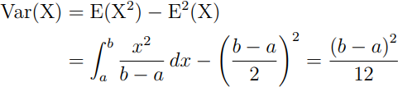

In our example, the expected value is:
Variance
The variance of a uniform distribution is:
In our example, the variance is:

Slide 38
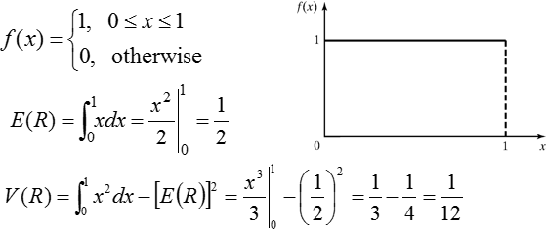
Standard Uniform Distribution
The standard uniform distribution is where a = 0 and b = 1 and is common in statistics, especially for random number generation.
Its expected value is 1/2 and variance is 1/12

Slide 39
Properties of Random Numbers
Uniformity: If the interval [0,1] is divided into n classes, or subintervals of equal length, the expected number of observations in each interval is N/n, where N is the total number of observations
Independence: The probability of observing a value in a particular interval is independent of the previous value drawn.
36

Slide 40
Techniques for Generating Random Numbers
Linear Congruential Method (LCM).
Most widely used technique for generating random numbers
Combined Linear Congruential Generators (CLCG).
Extension to yield longer period (or cycle)
Random-Number Streams.
37

Slide 41
Linear Congruential Method (1)
o To produce a sequence of integers, X₁, X₂, … between 0 and m-1
by following a recursive relationship:
X_{i+1} = (aX_{i} + c) mod m, i = 0,1,2,...
The
multiplier
The increment
The modulus
X₀ is called the seed
The selection of the values for a, c, m, and X₀ drastically affects the
statistical properties and the cycle length.
If c≠ 0 then it is called mixed congruential method
When c=0 it is called multiplicative congruential method
38

Slide 42
Linear Congruential Method (2)
o The random integers are being generated in the range [0,m-1], and to convert the integers to random numbers:
X
R =
i
, i = 1,2,...
i
m
39

Slide 43
Linear Congruential Method (3)
EXAMPLE: Use X₀ = 27, a = 17, c = 43, and m = 100.
The X_{i} and R_{i} values are:
X₁ = (17*27+43) mod 100 = 502 mod 100 = 2,
X₂ = (17*2+43) mod 100 = 77 mod 100 =77,
X₃ = (17*77+43) mod 100 = 1352 mod 100 = 52
…
R₁ = 0.02;
R₂ = 0.77;
R₃ = 0.52;
Notice that the numbers generated assume values only from the set I =
{0,1/m,2/m,….., (m-1)/m} because each X_{i} is an integer in the set
{0,1,2,….,m-1}
Thus each Ri is discrete on I, instead of continuous on interval [0,1]
40

Slide 44
Combined Linear Congruential Generators
Reason: Longer period generator is needed because of the increasing complexity of stimulated systems.
Approach: Combine two or more multiplicative congruential generators.
Let X_{i,1}, X_{i,2}, …, X_{i,k}, be the i^{th} output from k different multiplicative congruential generators.
The j^{th} generator:
Has prime modulus m_{j} and multiplier a_{j} and period is m_{j-1}
Produces integers X_{i,j} is approx ~ Uniform on integers in [1, m-1]
W_{i,j} = X_{i,j} -1 is approx ~ Uniform on integers in [1, m-2]

Slide 45
Combined Linear Congruential Generators
Suggested form:
The maximum possible period is:
The coefficient: Performs the subtraction X_{i,1-1}

Slide 46
Combined Linear Congruential Generators
Example: For 32-bit computers, L’Ecuyer [1988] suggests combining k = 2 generators with m₁ = 2,147,483,563, a₁ = 40,014, m₂ = 2,147,483,399 and a₂ = 20,692.
The algorithm becomes:
Step 1: Select seeds
X_{1,0} in the range [1, 2,147,483,562] for the 1st generator
X_{2,0} in the range [1, 2,147,483,398] for the 2nd generator.
Step 2: For each individual generator,
X_{1,j+1} = 40,014 X_{1,j} mod 2,147,483,563
X_{2,j+1} = 40,692 X_{1,j} mod 2,147,483,399.
Step 3: X_{j+1} = (X_{1,j+1} - X_{2,j+1} ) mod 2,147,483,562.
Step 4: Return
Step 5: Set j = j+1, go back to step 2.
Combined generator has period: (m₁ – 1)(m₂ – 1)/2 ~ 2 x 10¹⁸

Slide 47
Random-Numbers Streams
The seed for a linear congruential random-number generator:
Is the integer value X₀ that initializes the random-number sequence.
Any value in the sequence can be used to “seed” the generator.
A random-number stream:
Refers to a starting seed taken from the sequence X₀, X₁, …, X_{P.}
If the streams are b values apart, then stream i could defined by starting seed:
Older generators: b = 10⁵; Newer generators: b = 10³⁷.
A single random-number generator with k streams can act like k distinct virtual random-number generators
To compare two or more alternative systems.
Advantageous to dedicate portions of the pseudo-random number sequence to the same purpose in each of the simulated systems.

